Slide 1
English for
International
Communication

Slide 2
實戰篇 Unit 5
文法「填空題」
實力再加強

Slide 3
實戰篇 Unit 5
在「奠基篇」Unit 6 中已為您歸納Part 5 & Part 6 的基本題型，而基本的文法概念是正確作答的必要條件之一。因此，除了在奠基篇中學到的一些基本詞性概念、動詞時態、片語和常用字義比較外，我們在本單元中會再針對一些常考的文法重點作整理歸納及練習。

Slide 4
實戰篇 Unit 5
文法1 | 連接詞 | 對等連接詞 ‧從屬連接詞 連接副詞
文法2 | 關係代名詞 | 主格關係代名詞用法 受格關係代名詞用法 所有格關係代名詞用法 介系詞＋關係代名詞→關係副詞
文法3 | 比較級 | 程度相同時：A 與 B 程度相當 程度不同時：比較級（A 比 B～） 程度不同時：最高級 the + 比較級~, the + 比較級~ 特殊比較詞
文法4 | 使役動詞 | 使役動詞＋人 ‧使役動詞＋事／物 強調要求、命令或主張
文法5 | 假設語氣 | 真實情境 A. 敘述一種常態 B. 推測未來可能發生的事 C. 命令句 | 與事實相反情境 A. 與現在事實相反 B. 與過去事實相反

Slide 5
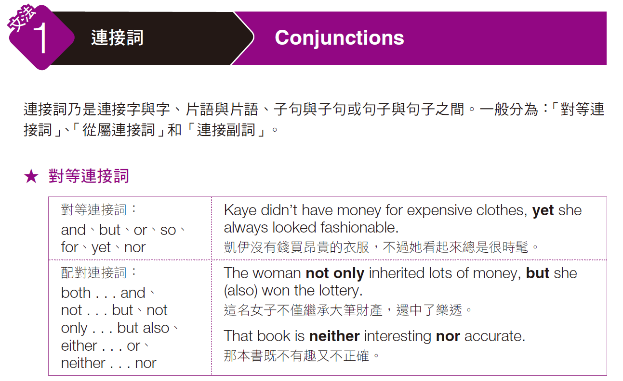
實戰篇 Unit 5

Slide 6
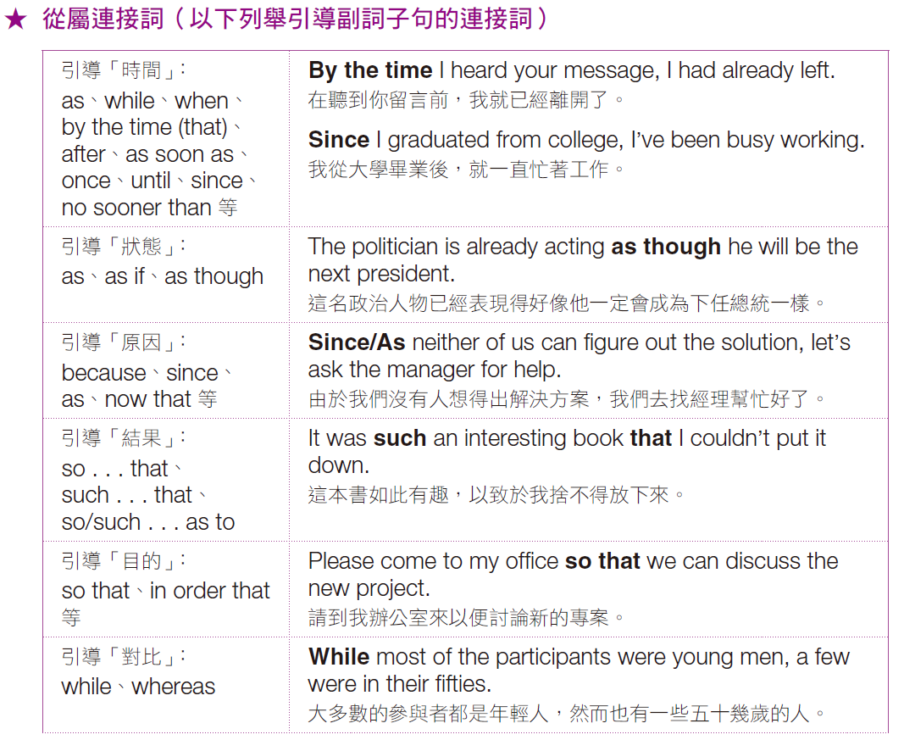
實戰篇 Unit 5

Slide 7
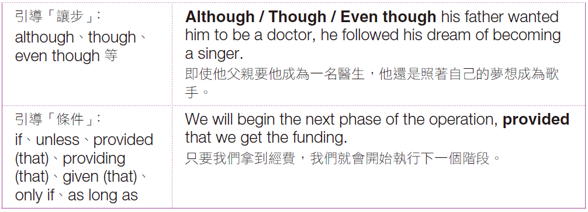
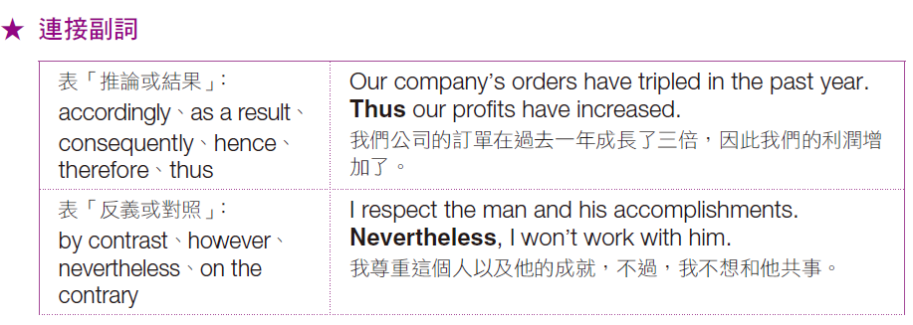
實戰篇 Unit 5

Slide 8
實戰篇 Unit 5
Exercise
A word or phrase is missing in each of the sentences below. Select the best answer to complete the sentence.
C
______ 1. Everyone agreed with the choice, ------- not for the reason that I thought they would.
(A) and
(B) so
(C) but
(D) or
每個人都同意那項選擇，但同意的原因跟我原本想的不同。

Slide 9
實戰篇 Unit 5
D
C
______ 2. We expect the factory’s output to increase, ------- we train enough workers.
(A) but
(B) nevertheless
(C) however
(D) providing
假使能訓練足夠的工人，我們預期工廠的產量就能增加。
______ 3. Sales fell below 60 million, ------- the year-end goal was 80 million.
(A) so
(B) if
(C) whereas
(D) besides
業績低於六千萬，而年底的目標卻是八千萬。

Slide 10
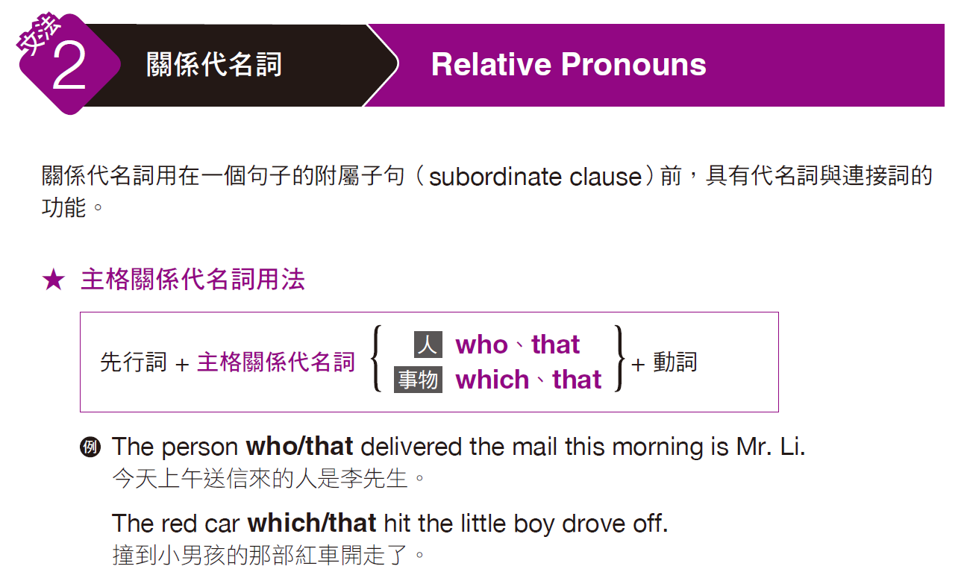
實戰篇 Unit 5

Slide 11
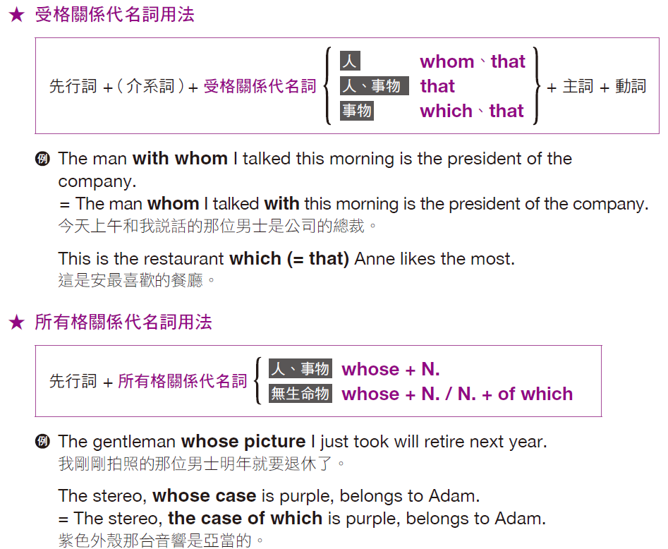
實戰篇 Unit 5

Slide 12
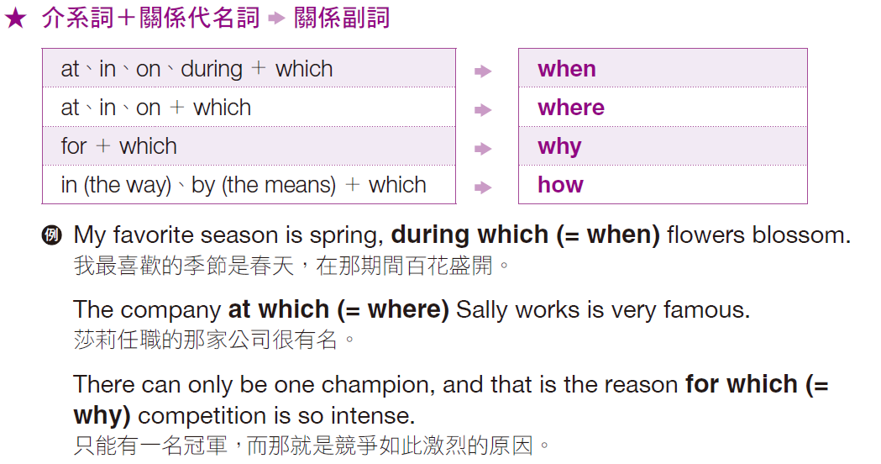
實戰篇 Unit 5

Slide 13
實戰篇 Unit 5
Exercise
A word or phrase is missing in each of the sentences below. Select the best answer to complete the sentence.
C
______ 1. The employee ------- phone is ringing is out sick today.
(A) who
(B) whom
(C) whose
(D) who’s
電話正在響的那名職員今天生病不在。

Slide 14
實戰篇 Unit 5
C
B
______ 2. Three thirty is usually the time ------- the mailman delivers the mail.
(A) which
(B) for which
(C) at which
(D) how
三點半是郵差一般送信的時間。
______ 3. Mt. Kilimanjaro, ------- peak is covered with snow, is the tallest mountain in Africa.
(A) which
(B) whose
(C) whom
(D) where
白雪覆蓋的吉力馬扎羅山是非洲最高的一座山。

Slide 15
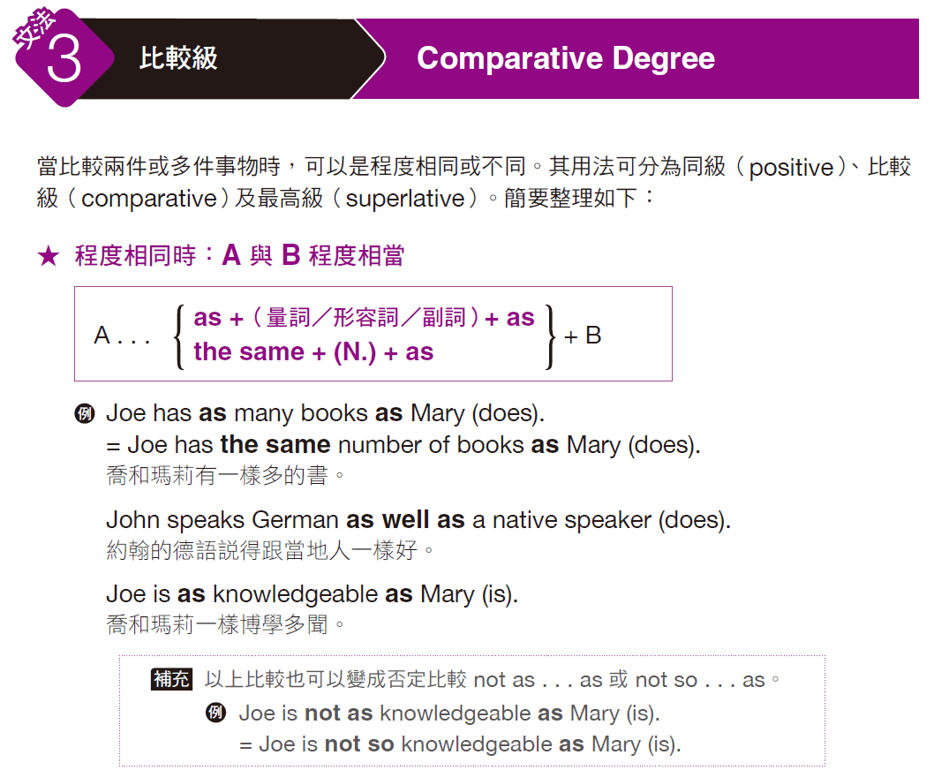
實戰篇 Unit 5

Slide 16
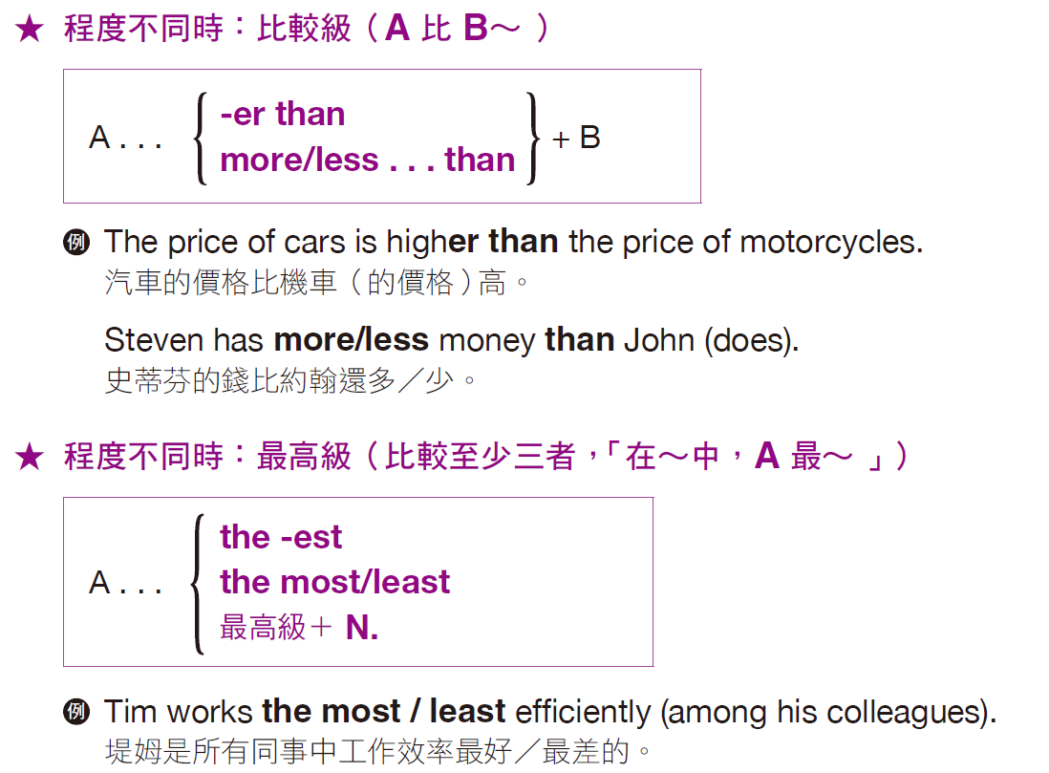
實戰篇 Unit 5

Slide 17
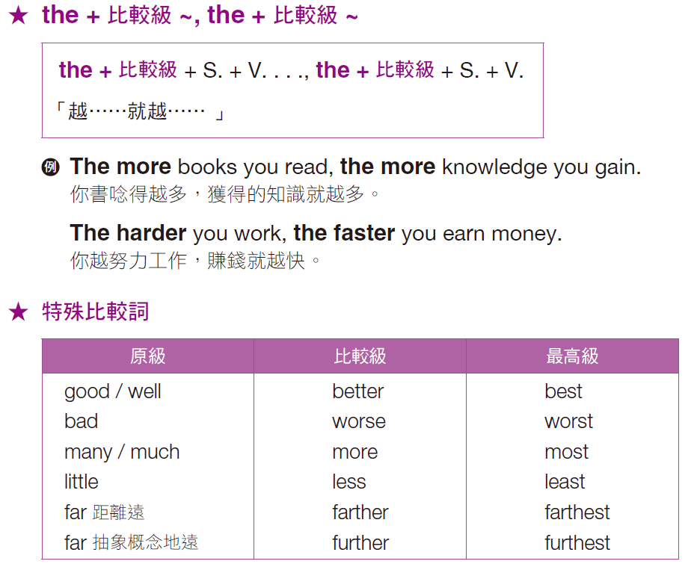
實戰篇 Unit 5

Slide 18
實戰篇 Unit 5
Exercise
A word or phrase is missing in each of the sentences below. Select the best answer to complete the sentence.
D
______ 1. The more Chris practiced his presentation, ------- confident he became.
(A) much more
(B) as more
(C) more than
(D) the more
克里斯越練習他的簡報就越有自信。

Slide 19
實戰篇 Unit 5
B
A
______ 2. Henry’s house is three times ------- John’s house.
(A) bigger
(B) bigger than
(C) than
(D) more than
亨利的家比約翰的家大三倍。
______ 3. While Karen isn’t the most talented player on the team, she is by no means the -------.
(A) least
(B) most
(C) worst
(D) good
雖然凱倫不是球隊裡最有天賦的球員，但她絕不是最沒有天賦的。

Slide 20
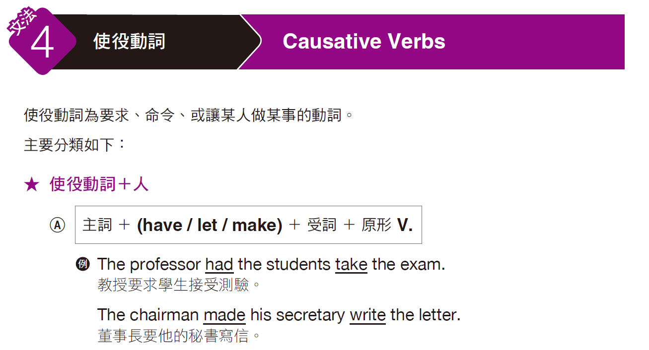
實戰篇 Unit 5

Slide 21
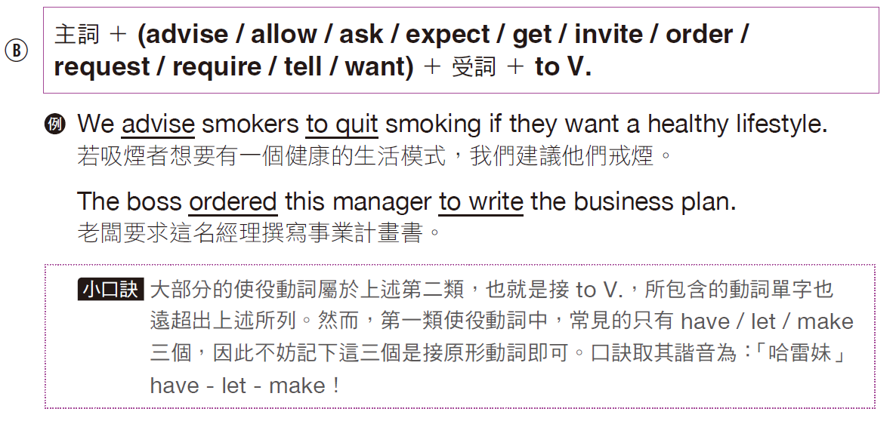
實戰篇 Unit 5

Slide 22
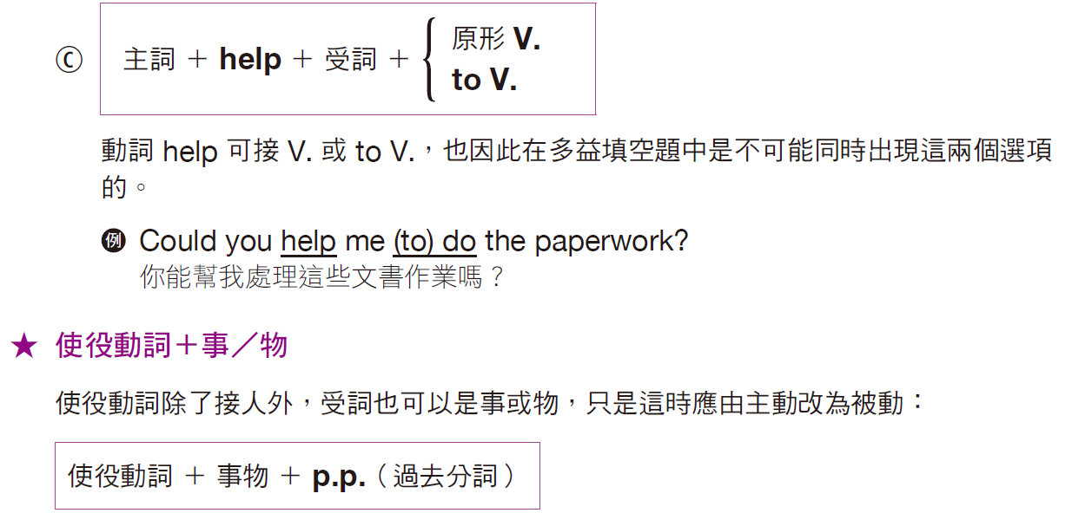
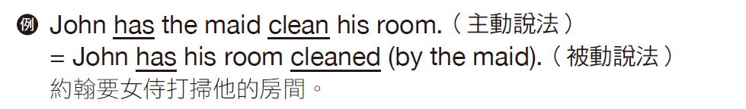
實戰篇 Unit 5

Slide 23
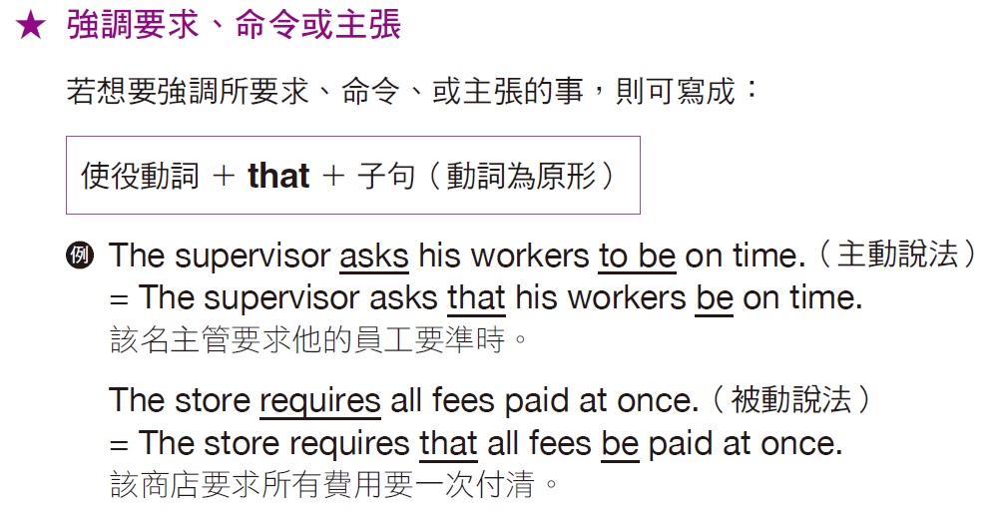
實戰篇 Unit 5

Slide 24
實戰篇 Unit 5
Exercise
A word or phrase is missing in each of the sentences below. Select the best answer to complete the sentence.
A
______ 1. The purpose of the speech is to help the company
------- potential suppliers.
(A) find
(B) finding
(C) found
(D) of finding
那場演講的目的是幫助公司找到潛在的供應商。

Slide 25
實戰篇 Unit 5
B
A
______ 2. The authorities have the examined companies ------- financial reports.
(A) to submit
(B) submit
(C) be submitting
(D) submitted
有關當局要求被審查的公司提交財務報告。
______ 3. We request that the new price ------- to all of our European stores.
(A) apply
(B) to apply
(C) applying
(D) applied
我們要求歐洲所有分店都要採用新的價格。

Slide 26
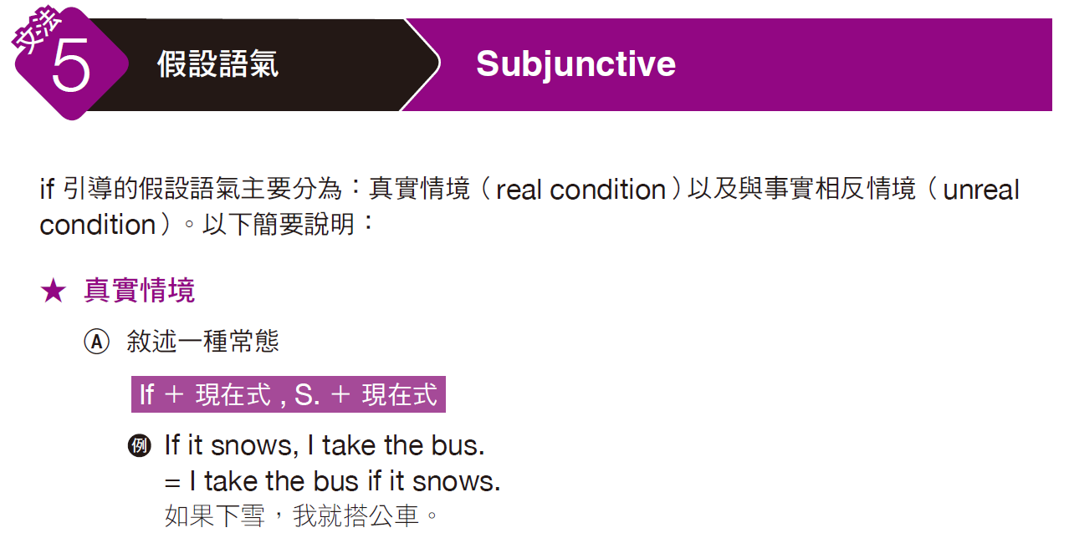
實戰篇 Unit 5

Slide 27
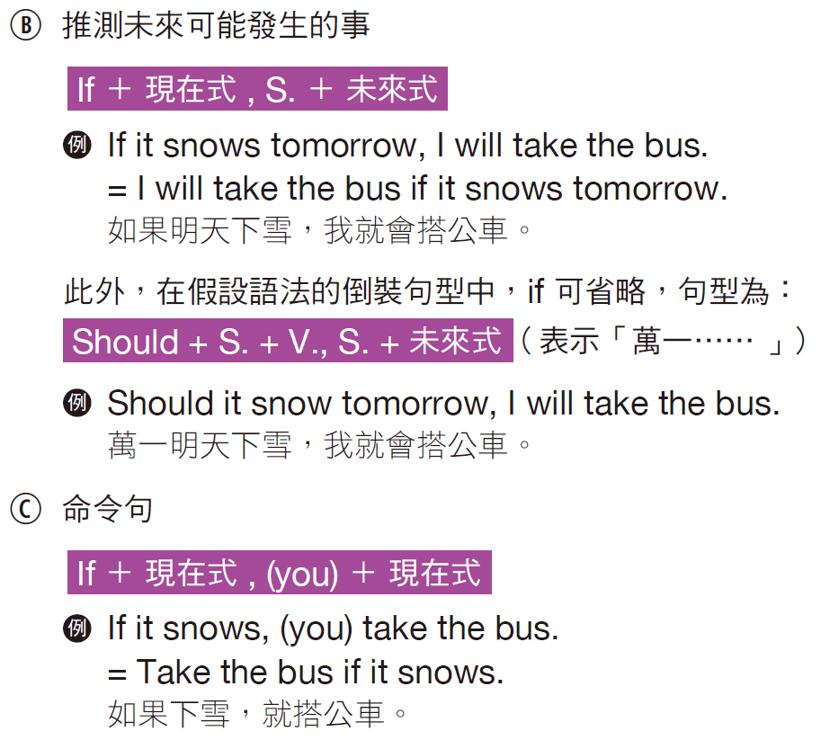
實戰篇 Unit 5

Slide 28
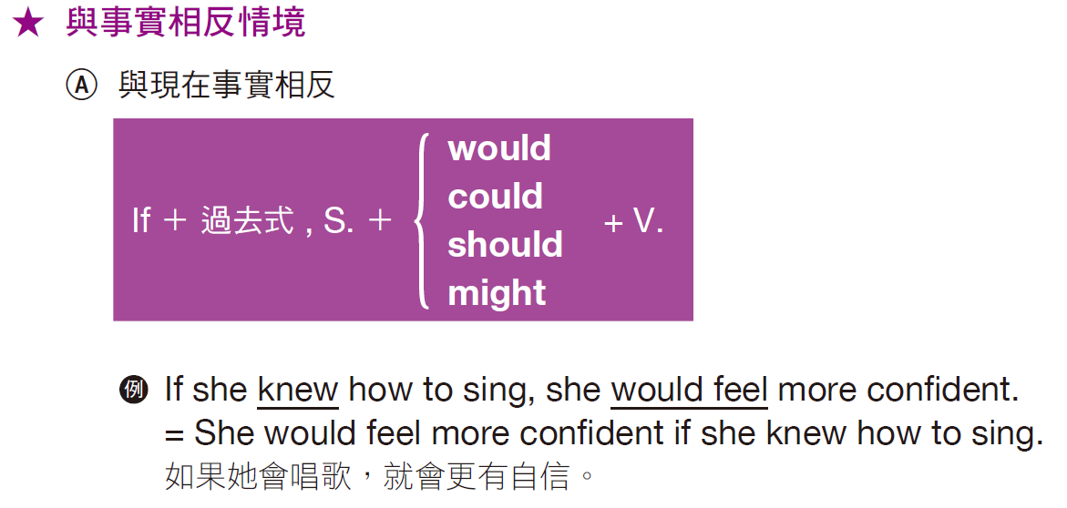
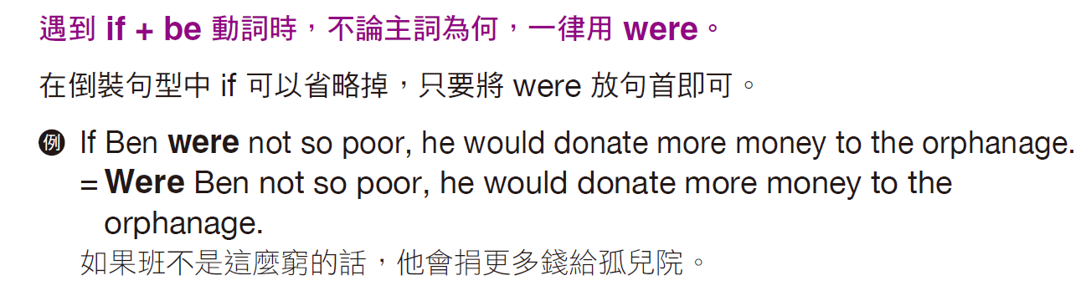
實戰篇 Unit 5

Slide 29
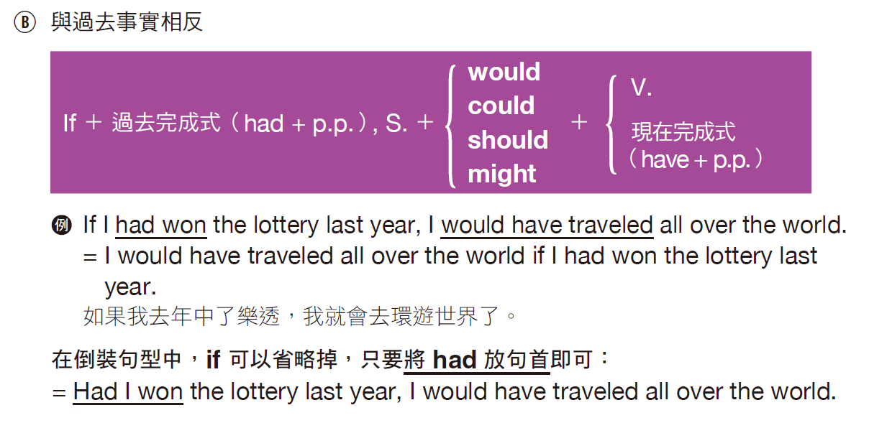
實戰篇 Unit 5

Slide 30
實戰篇 Unit 5
Exercise
A word or phrase is missing in each of the sentences below. Select the best answer to complete the sentence.
B
______ 1. Were Dan more patient, he ------- his house for a better price.
(A) will sell
(B) could sell
(C) should have sold
(D) could have been sold
如果丹更有耐心，他就能以更好的價錢賣出房子。

Slide 31
實戰篇 Unit 5
______ 2. If Sam had told me about the meeting, I ------- the report earlier.
(A) will finish
(B) would finish
(C) would have finished
(D) had finished
如果山姆有告訴我開會的事，我就會早一點完成報告。
______ 3. ------- Bill left college, he wouldn’t have the great job he has now.
(A) If
(B) Were
(C) Was
(D) Had
如果比爾離開了學校，他現在就不會有現在這麼好的工作了。
C
D

Slide 32
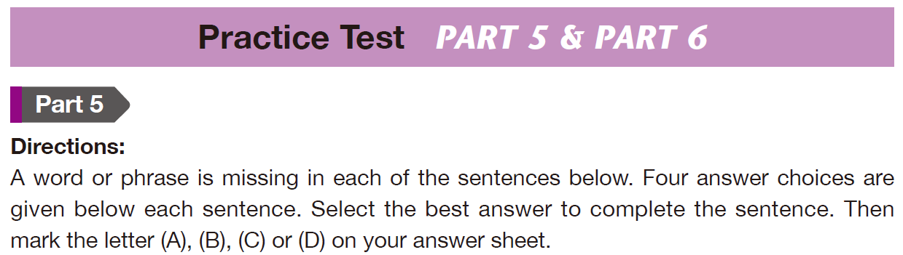
實戰篇 Unit 5

Slide 33
實戰篇 Unit 5
C
C
______ 1. ------- of the sales representatives do you want to work with, Lenny, Doris or Kim?
(A) Who
(B) Whose
(C) Which
(D) What
你想跟哪個業務代表工作，藍尼、朵瑞絲還是金？
______ 2. We haven’t held a companywide meeting ------- we got a new manager.
(A) for
(B) during
(C) since
(D) then
自從新經理上任後，我們都還沒有開過一次全公司的會議。

Slide 34

實戰篇 Unit 5
B
A
______ 3. If Sue hadn’t forgotten the envelopes, we ------- all the letters this morning.
(A) could mailed
(B) could have mailed
(C) had been mailed
(D) had mailed
如果蘇沒有忘記準備信封，我們今天早上就可以郵寄所有信件。
______ 4. The company’s new sales director is much more experienced ------- the previous director.
(A) than
(B) of
(C) for
(D) at
公司新的銷售主管比前一位有經驗多了。

Slide 35
實戰篇 Unit 5
C
D
______ 5. The problem with many business ideas is that the start-up costs are ------- high.
(A) also
(B) in addition
(C) too
(D) as well
很多經營理念的問題是起初的成本太高。
______ 6. Most of the clinic’s patients are feeling much ------- than they were yesterday.
(A) good
(B) well
(C) best
(D) better
診所裡大多數的病人都覺得比昨天好多了。

Slide 36
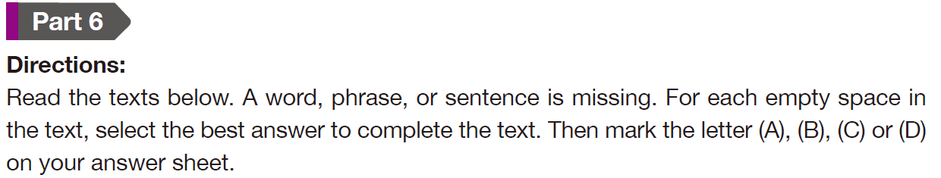
實戰篇 Unit 5

Slide 37
實戰篇 Unit 5
Questions 7-10 refer to the following recipe.
Long Beach Grilled Cheese Sandwich First, prepare two slices of whole wheat bread, two slices of sharp cheddar cheese and three tablespoons of butter. Many people today ___7___ margarine to butter, and that is a good choice, but for cooking certain dishes, real butter provides a far ___8___ flavor.
C
7. (A) like
(B) care
(C) prefer
(D) choice
8. (A) rich
(B) to rich
(C) richer
(D) richest
C

Slide 38
實戰篇 Unit 5
Melt two tablespoons of butter over medium heat in a flat frying pan, spreading the butter around. Next, add the two slices of bread. When ___9___ have browned on the bottom, add another tablespoon of butter. Flip one piece of bread, add the two slices of cheese on the browned side, and then top it with the other slice. Cover the frying pan and cook for two to three minutes, flipping the sandwich once or twice. That’s it! Your sandwich is now ready to be enjoyed. ___10___
B
9. (A) two
(B) both
(C) pair
(D) duo
B
10. (A) Don’t forget to take out the butter.
(B) As a recommendation, serve with chips.
(C) Now you can turn up the heat.
(D) Add ice to the beverage if you want it cold.

Slide 39
實戰篇 Unit 5
中文翻譯
長灘燒碳乳酪三明治
首先，準備兩片全麥麵包，兩片長期熟成的切達起司，三大匙奶油。現在很多人比較喜歡乳瑪林而非奶油，這個選擇是不錯，但在烹飪某些菜的時候，真正的奶油能提供更濃郁的風味。
以中火將兩大匙奶油在平底鍋中融化，讓奶油均勻覆蓋鍋內。接下來，放入那兩片麵包，待兩片麵包底部焦黃時，再加入一大匙奶油。將其中一片麵包翻面，將兩片起司置放於麵包的焦黃面，然後蓋上另一片麵包。
將平底鍋鍋蓋蓋上，烹煮兩至三分鐘，將三明治翻面一至二次。大功告成了！你的三明治現在已準備好可以享用了。建議搭配洋芋片一起食用。
• cheddar (n.) 切達乾酪 • margarine (n.) 人造黃油；乳瑪林 • spread (v.) 塗；敷

Slide 40
實戰篇 Unit 5
Questions 11-14 refer to the following company announcement.
TO: All Employees Because of our company’s recent expansion, we will be moving into a new and larger office space at 555 Broadway in the Oakland City Center complex in downtown Oakland. The building is centrally ___11___ next to a BART mass transit station and other transportation, and the location puts our company near many of our clients in Oakland, and a short subway ride on BART to clients in San Francisco.
C
11. (A) locate
(B) locates
(C) located
(D) locating

Slide 41
實戰篇 Unit 5
Many of our employees will also enjoy the location ___12___ it is right next to Oakland’s Chinatown, ___13___ offers wonderful restaurants and a variety of shops. Downtown Oakland also has a wide range of excellent restaurants. We will be moving in the first week of June. Please contact your supervisor or department head. ___14___
A
(A) since
(B) while
(C) although
(D) whereas
13. (A) that
(B) what
(C) whose
(D) which
12.
A
(A) He or she can give you details on your individual moves.
(B) If you want to stay at the current location, then you do not need to respond.
(C) Further questions will be fielded at the Chinatown restaurant.
(D) You should not see any change in your rental charges.
14.
D

Slide 42
實戰篇 Unit 5
中文翻譯
致「全體員工」
我們公司由於在日前擴張營運，因此將會搬遷到另一棟辦公空間更大的新大樓，地點就位在奧克蘭市鬧區，百老匯街 555 號的奧克蘭市中心綜合大樓。該棟大樓位於市區正中心，緊鄰灣區捷運車站和其他交通設施，這個地點讓我們公司更接近我們許多在奧克蘭的客戶，而且只要搭乘短程的灣區捷運，就能抵達位於舊金山市的客戶端。
我們很多員工也會喜歡這個地點，因為它的旁邊就是奧克蘭市的中國城，那裡有很棒的餐廳和各式各樣的商店。奧克蘭鬧區也有種類繁多的一流餐廳。
我們將會在六月的第一個星期進行搬遷。請聯繫你的主管或部門經理。他或她會提供你個人搬遷的細節資訊。
• complex (n.) 綜合設施 • transit (n.) 轉變；過渡 • a wide range of 種類繁多的……

Slide 43
實戰篇 Unit 5
文法「填空題」
實力再加強
-The End-

